Slide 1
Lesson objective
Title: Evaluating indices
Aim:
Evaluate indices with positive powers
Plan:
Review
  Integers
  Square numbers
Evaluating indices
Need calculators and whiteboards

Slide 2
Addition and Subtraction: A number-line approach
To use the number line you need a starting point, a direction and a number of places to move.
Example: -3 – 5
Starting point
Number of places
Direction:
+ move right
– move left
Notes:
Student worksheet 1

Slide 3
Independent practice: exercise books.
-2 – 6
-3 + 8
4 – 7
8 – 5
5 – 8
-3 – 3
5 – 7
-5 – 6
-4 – 8
10 – 19
-8
5
-3
3
-3
-6
-2
-11
-12
-9
Copy the question and use correct setting out to present your answer.
Notes:
Could use Choral reading and reversal on integer definition

Slide 4
Addition and Subtraction: Double signs.
Example: -3 – (-5)
Using patterns to develop understanding.
6 – 3 =
6 – 2 =
6 – 1 =
6 – 0 =
6 – (-1) =
6 – (-2) =
6 – (-3) =
3
4
5
6
7
8
9
Subtracting a negative number is the same as

Slide 5
Addition and Subtraction: Double signs.
Using patterns to develop understanding.
6 + 3 =
6 + 2 =
6 + 1 =
6 + 0 =
6 + (-1) =
6 + (-2) =
6 + (-3) =
9
8
7
6
5
4
3
Adding a negative number is the same as subtracting.

Slide 6
Independent practice: exercise books.
-2 + (– 6)
-3 – (- 8)
4 + (– 7)
8 – (-5)
-5 – 8
-2 + (– 3)
5 – (-11)
-5 + (– 13)
3 – (-4.6)
-20 – (-35)
Copy the question
Replace double sings
Present your answer.
3 lines of working!
Notes:
Could use Choral reading and reversal on integer definition

Slide 7
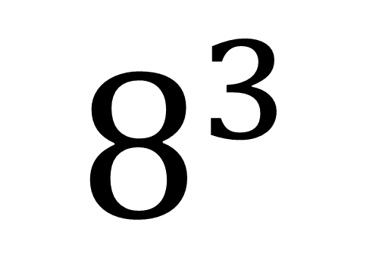
The index number
(or exponent, indices or power)
How many of the Base number we need in the multiplication
The BASE number
(BIG IS BASE)
It is the number that is repeated in the multiplication.
$$8^{3}$$
= 8 x 8 x 8

Slide 8

Match the expanded form
7 x 7 x 7 x 7
7 x 7
7 x 7 x 7 x 7 x 7 x 7
7 x 7 x 7
$$7^{3}$$
$$7^{6}$$
$$7^{2}$$
$$7 ×2$$
$$7^{4}$$

Slide 9
The word is
Evaluate
Find a numerical expression
Provide an answer as a number

Slide 10

Evaluating indices: I do
${ 2}^{4}$
${ 3}^{3}$
${ 5}^{2}$

Slide 11

Whiteboards
Evaluate
Simplify
$$2^{3}$$
$$4^{2}$$
$$1^{8}$$
$$5^{2} −5$$
9 x 9 x 9
11 x 11 x 11 x 11 x 11
2 x 2 x 2 x 2
3 x 3

Slide 12
Multiple base numbers
Simplify:
3 x 3 x 4 x 3 x 4 x 5 x 5 x 4
2 x 3 x 4 x 3 x 2 x 2 x 4 x 3
Write the base numbers
Count repeats for indices

Slide 13
Whiteboards
Write the base numbers
Count repeats for indices
2 x 7 x 7 x 7 x 2 x 2 x 7
9 x 11 x 8 x 8 x 9 x 11 x 11 x 11 x 9 x 8

Slide 14
Individual practice
Complete task sheet NA 17 Index notation.

Slide 15
Reflection: fist to 5
Aim:
Evaluate indices with positive powers

